Slide 1
Lecture 5
Introduction OOAD

Slide 2
Agenda
Compare and contrast analysis and design.
Define object-oriented analysis and design (OOA/D).
Illustrate a brief example.

Slide 3
Analysis
Analysis emphasizes an investigation of the problem and requirements, rather than a solution.
For example, if a new computerized library information system is desired, how will it be used?
"Analysis" is a broad term, best qualified, as in requirements analysis (an investigation of the requirements) or object analysis (an investigation of the domain objects).
.

Slide 4
Design
Design emphasizes a conceptual solution that fulfills the requirements, rather than its implementation.
For example, a description of a database schema and software objects. Ultimately, designs can be implemented

Slide 5
What Is Object-Oriented Analysis and Design?
object-oriented analysis, there is an emphasis on finding and describing the objects—or concepts—in the problem domain.
For example, in the case of the library information system, some of the concepts include Book, Library, and Patron.
object-oriented design, there is an emphasis on defining software objects and how they collaborate to fulfill the requirements.
For example, in the library system, a Book software object may have a title attribute and a getChap-ter method

Slide 6
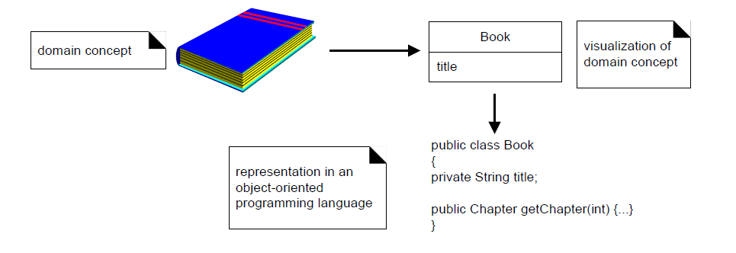

Slide 7
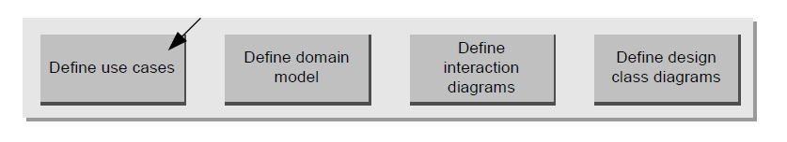
Overall Picture of OOAD

Slide 8
Define Use cases
Use cases are not an object-oriented artifact—they are simply written stories.
However, they are a popular tool in requirements analysis and are an important part of the Unified Process.
For example, here is a brief version of the Play a Dice Game use case:
  Play a Dice Game: A player picks up and rolls the dice. If the dice face value total seven, they win; otherwise, they lose.

Slide 9
Define a Domain Model
A decomposition of the domain involves an identification of the concepts, attributes, and associations that are considered noteworthy.
The result can be expressed in a domain model, which is illustrated in a set of diagrams that show domain concepts or objects.

Slide 10
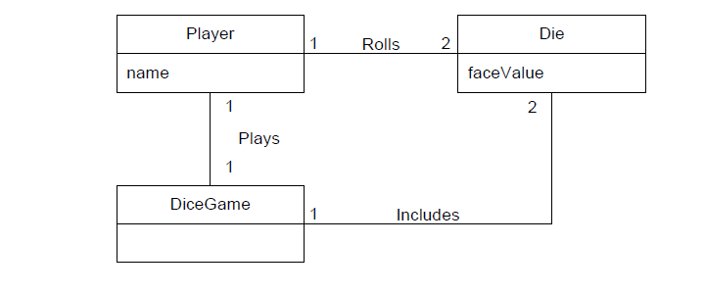
Partial domain model of the dice game.

Slide 11
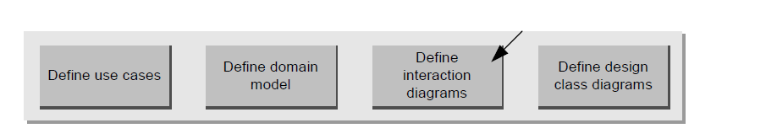
Define Interaction Diagrams

Slide 12
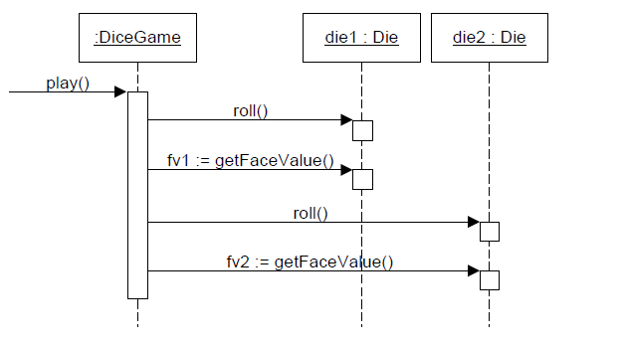
Interaction diagram illustrating messages between software objects.

Slide 13
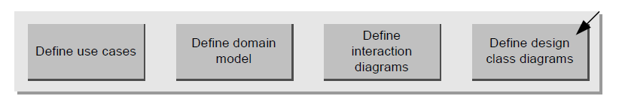
Define Design Class Diagrams

Slide 14
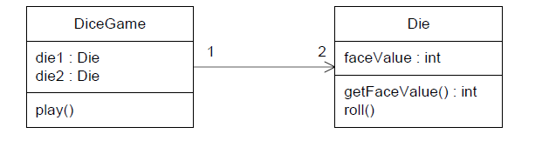
Partial design class diagram

Slide 15
References
Applying UML and Patterns: An Introduction to Object-Oriented Analysis and Design and Iterative Development

Slide 16


